Slide 1

DEPARTMENT OF ELECTRONICS AND COMMUNICATION ENGINEERING
“LPG gas leakage detection using Arduino UNO”
Presented By :
B.Kruthika 235U5A0402
CH.Poojitha 235U5A0404
G.Vaishnavi 235U5A0406
G.Nikitha 235U5A0407
Project Guide:
Mr. J.Venkatesh Assistant Professor

Slide 2
CONTENTS
Abstract
Hardware & Software used
Block Diagram
Components
Working
Advantages
Applications
Conclusion
Future Scope

Slide 3
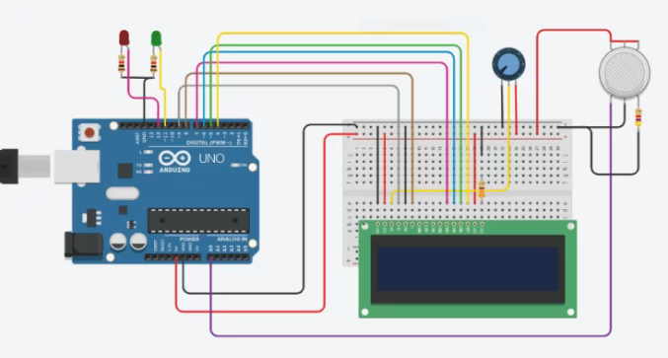
ABSTRACT
This presentation proposes a novel approach for detecting LPG gas leakage utilizing a Arduino UNO.
The system comprises gas sensors interfaced with a Arduino, which continuously monitors the environment for any abnormal gas concentration.
This system offers real-time monitoring, high
sensitivity, and fast response, making it an
effective solution for ensuring household and
industrial safety against LPG gas leaks.

Slide 4
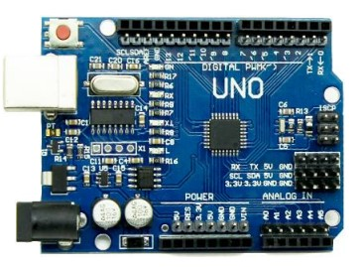
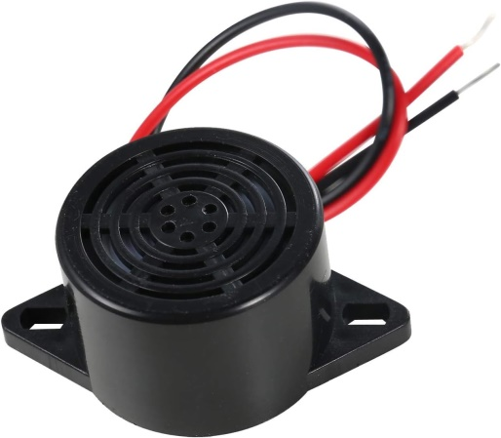
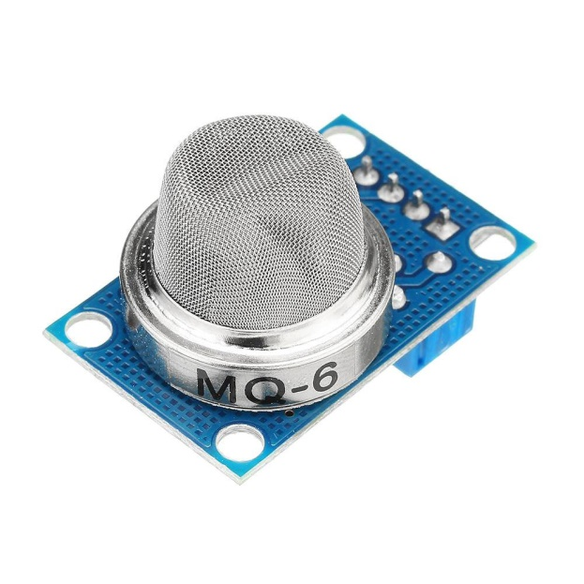
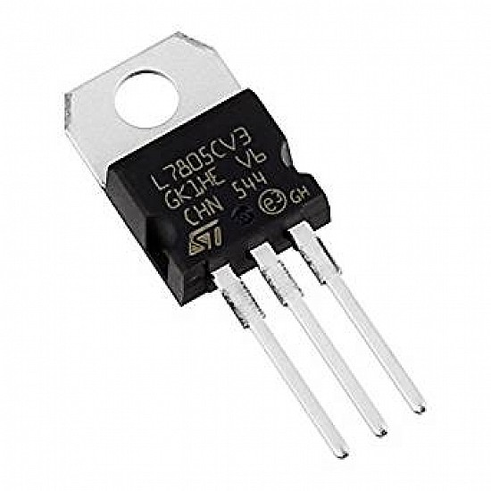
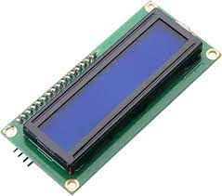
SOFTWARE AND HARDWARE
Software use:
Arduino IDE
Hardware used:
Arduino UNO
MQ6 Sensor
Buzzer
LCD Display
Voltage Regulator

Slide 5
BLOCK DIAGRAM
.
VOLTAGE REGUKATOR
ARDUINO UNO
BUZZER
MQ6 SENSWOR

Slide 6
COMPONENTS
Arduino UNO :
Arduino UNO is a microcontroller board
based on the ATmega328P.
It has 14 digital input/output pins
6 analog inputs, a 16 MHz ceramic resonator, a USB connection, a power jack, an ICSP header and a reset button.

Slide 7
VOLTAGE REGULATOR :
A voltage regulator is a system designed to
automatically maintain a constant voltage.
Digital electronic devices need digital supply and we get supply from regulated power supply.
When the switch is on, energy is stored in an inductor or capacitor. When the switch is off, this stored energy is released to the load.

Slide 8

MQ6 Sensor :
The MQ-6 sensor is a gas sensor specifically
designed to detect the presence of LPG
(liquefied petroleum gas) or propane in the air.
It's commonly used in gas leak detection systems for homes, industries, and automotive applications.
When it comes in contact with LPG or propane gas, the sensor's conductivity changes, allowing it to detect the gas concentration in the air.

Slide 9
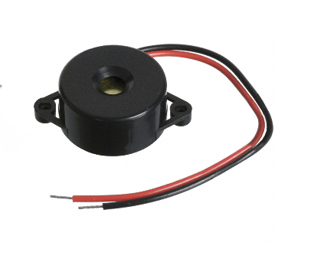
BUZZER :
A buzzer is an electronic component used to
produce sound. In LPG gas detection
systems, buzzers are typically used to alert
users when gas is detected.
Gas Sensor: Detects the presence of LPG gas.
Microcontroller: Processes the signal from the gas sensor.
Buzzer Activation: The microcontroller activates the buzzer if the gas concentration exceeds a certain threshold.

Slide 10

LCD Display:
It refers to a flat-panel display
technology that uses liquid crystals
sandwiched between two layers of polarizing material to create images.
LCDs are widely used in computer monitors, televisions, smartphones, and various other devices.

Slide 11
WORKING
As in the form of a comprehensive block diagram, gas sensor will be the first to detect any hazard gases and relay the information to the Arduino UNO board.
A sensor is connected to the Arduino, which senses the hazard gases and give information to the Arduino (as program is dumped in it by using Arduino IDE software).
A buzzer and LCD is also connected to the Arduino at its output port. When the sensor detects the leakage of gas then we get beep sound of buzzer and displayed a warning message on the LCD screen

Slide 12
ADVANTAGES
Less complex circuit.
Low power consumption.
Hazards free circuit

Slide 13
APPLICATIONS
It can be used in gas industries and domestic.
It is used in mining of coal and other materials.
It is used in municipal gas distribution.
It is used in nuclear power stations.

Slide 14
FUTURE SCOPE
To Gas leakage detection adding battery backup options to ensure the system remains operational during power outages. Exploring energy-efficient components to extend battery life and enhance reliability.
Future improvements could include adding wireless communication modules for remote monitoring, integrating with IOT platforms for advanced data analytics,
Continuous research and development in this area will likely lead to more sophisticated, cost-effective, and reliable gas leakage detection systems in the future

Slide 15
CONCLUSION
The previous listed applications of this Arduino based security system are based on the fact that this system is able to detect any sort of gas leakage.
This system not only enhances safety but also demonstrates the practical application of Arduino technology in addressing critical issues.
Due to this accidents caused by gas leak can be prevented.

Slide 16
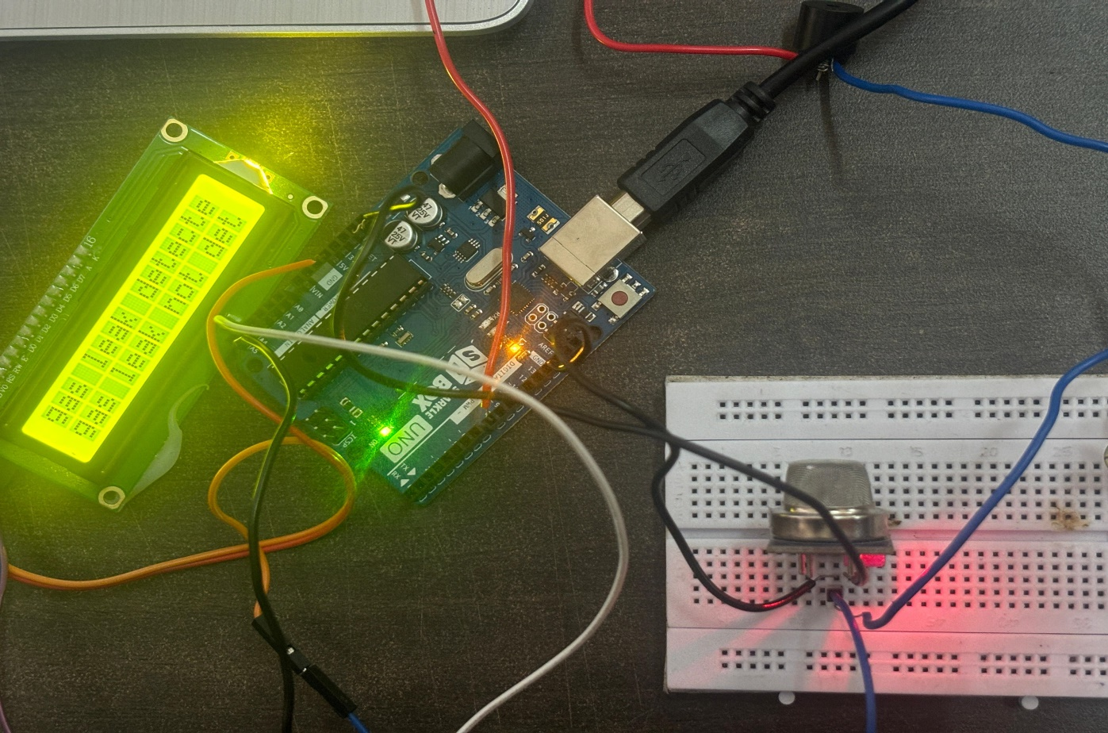
RESULT
The MQ-6 gas sensor successfully detected presence of LPG Gas in the air.
and displayed a warning message on the LCD screen

Slide 17
* THANK YOU *

